Slide 1

Recurrent Neural Networks
Backpropagation through time
deeplearning.ai

Slide 2






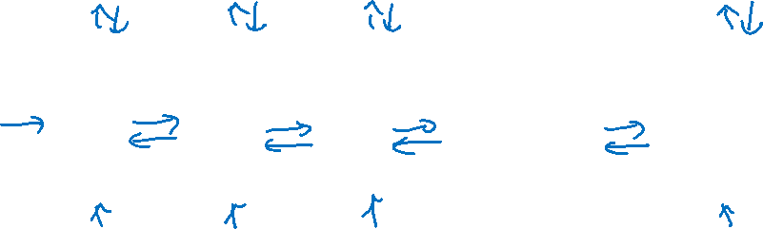







Forward propagation and backpropagation
$${\hat{y}}^{<1>}$$
$${\hat{y}}^{<2>}$$
$${\hat{y}}^{<3>}$$
$${\hat{y}}^{<T_{y}>}$$
$$a^{<1>}$$
$$a^{<2>}$$
$$a^{<T_{x}−1>}$$
$$a^{<0>}$$
$$⋯$$
$$x^{<1>}$$
$$x^{<2>}$$
$$x^{<3>}$$
$$x^{<T_{x}>}$$

Slide 3

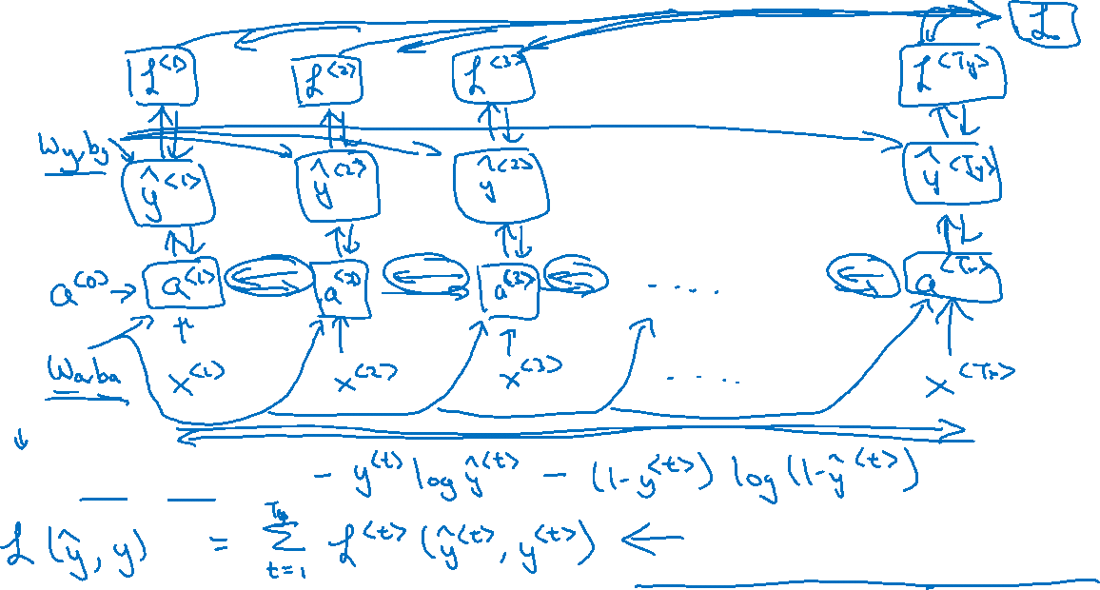
Forward propagation and backpropagation
$$ℒ^{<t>}\left({\hat{y}}^{<t>},y^{<t>}\right)=$$
Backpropagation through time

